Slide 1
Timesheet Management
Student: Redinciuc Daniel-Ilie
Coordinator: Lect. Dr. Ionuț Pistol

Slide 2
Motivation
Studies show that 98% of the people between 20 and 24 years old are using some form of time management
Managing your time increases efficiency and is also reduces the stress
In the business world, time management became pretty much mandatory
This application want to help the students of the Computer Science students better organize their time

Slide 3
Stand-outs
The application is not just a calendar application
It offers event integration with the timesheet of the faculty
Gives the chance to organize your schedule as you want
The student can provide a feedback on why he wants to change the class
Admins can extract reports

Slide 4
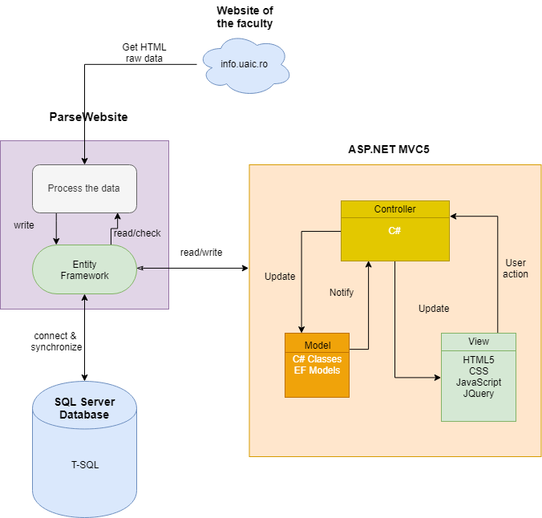
Application architecture

Slide 5
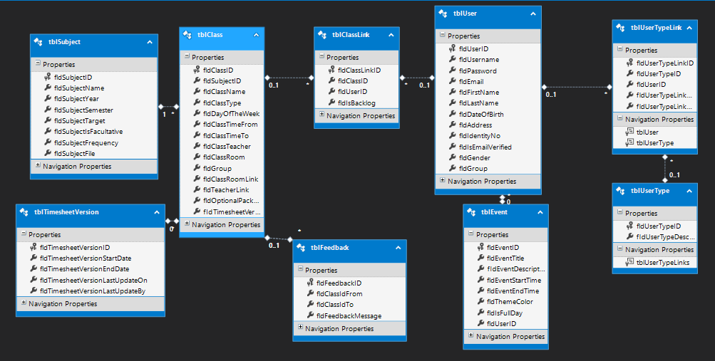
Database structure

Slide 6
DEMO

Slide 7
Future directions
The platform could be linked with the database of the faculty so that the new students could be added automatically;
A mobile application could be developed in order to increase the usage of the schedule;
A machine learning algorithm could be added in order to detect user’s custom events and make suggestions of recurrent events;
Another interesting feature would be to integrate voice assistants in order to create, edit, or delete events from the calendar with your voice

